Slide 1
Localizing Backscatters by a Single Robot With Zero Start-up Cost
Shengkai Zhang¹, Wei Wang¹, Sheyang Tang¹, Shi Jin², and Tao Jiang¹
¹Huazhong University of Science and Technology, ²Southeast University
Notes:
Hello. Nice to meet you. We present a novel backscatter localization system that works by a single robot with zero start-up cost. I am Shengkai Zhang, a PhD Candidate from Huazhong University of Science and Technology.

Slide 2
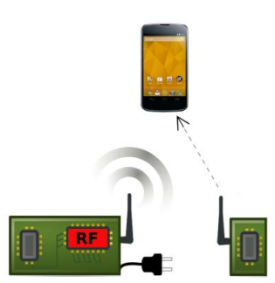
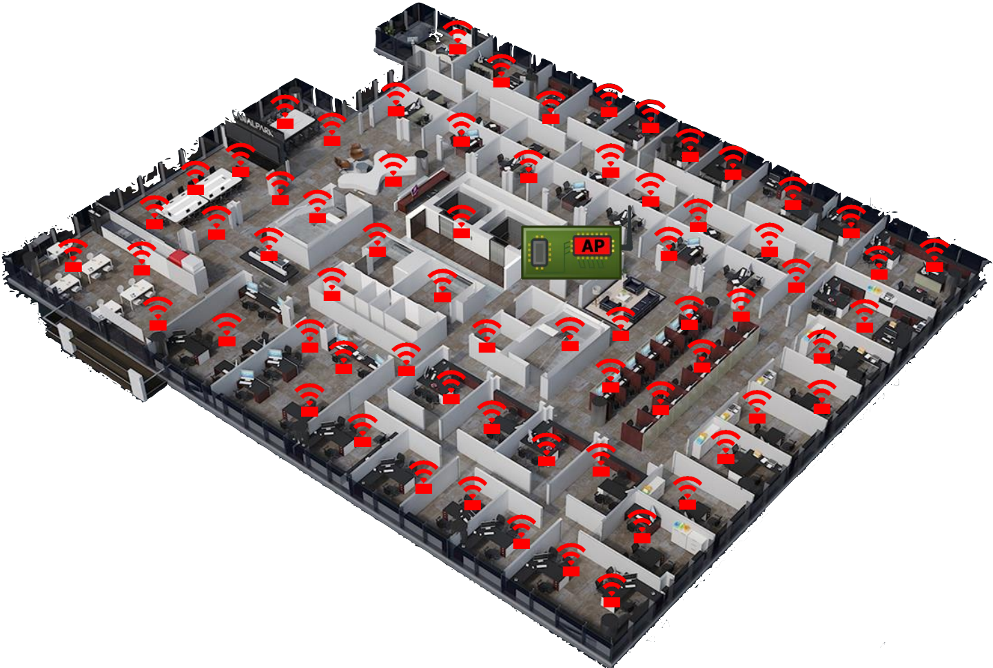
Backscatter Brings Universal IoT Deployment
Backscatter as an Desirable Alternative
Low-power communication: 10-year operation with a button cell battery
Passive WiFi
NetScatter
Backscatter networking: Enable hundreds of concurrent transmissions
Localizing Backscatters by a Single Robot With Zero Start-up Cost
Shengkai Zhang, Wei Wang, Sheyang Tang, Shi Jin, and Tao Jiang. Huazhong University of Sci. & Tech.
2
Notes:
Recently, the innovations of backscatter technology have driven the realization of universal IoT deployment. The major breakthrough is two-fold: low-power communication enables 10-year operation with a button cell battery, and the backscatter networking protocol enables concurrent transmissions.

Slide 3
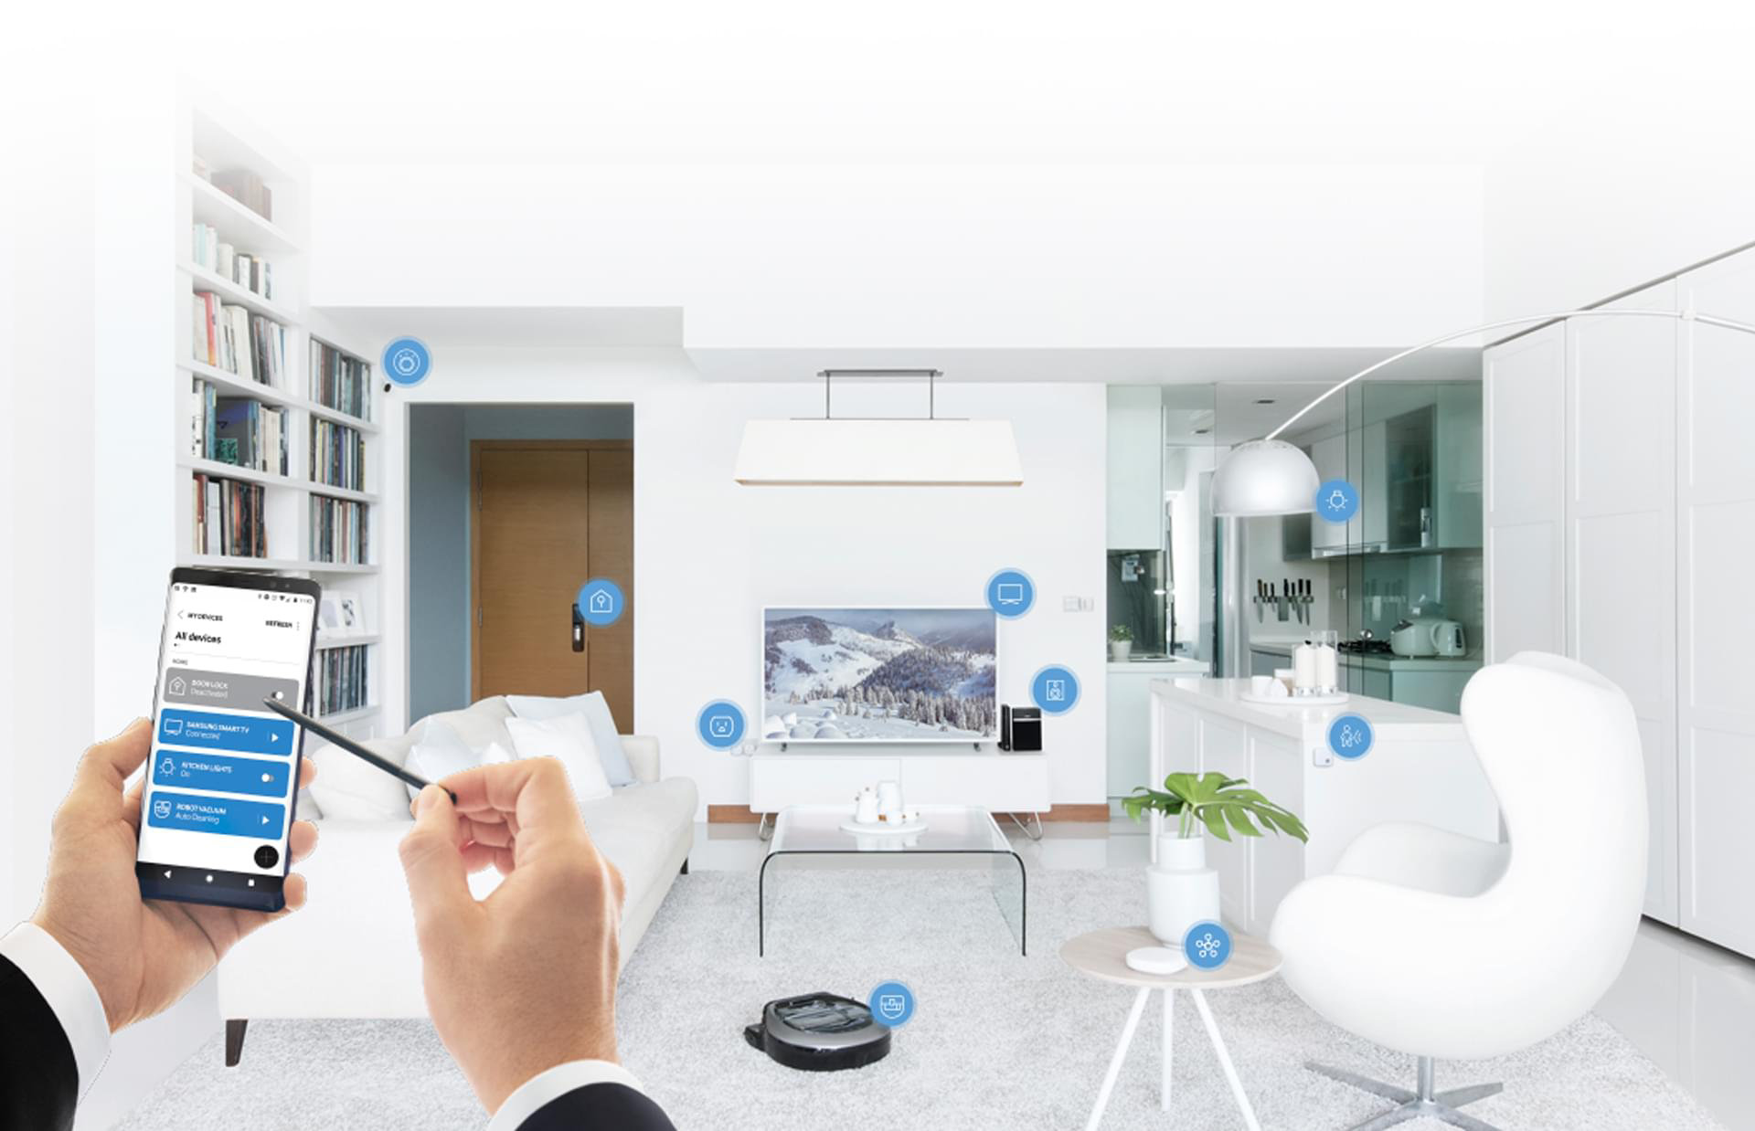
Location: The Key to IoT Smart Services
Smart warehouse
Smart home
Localizing Backscatters by a Single Robot With Zero Start-up Cost
Shengkai Zhang, Wei Wang, Sheyang Tang, Shi Jin, and Tao Jiang. Huazhong University of Sci. & Tech.
3
Notes:
Such a universal IoT deployment brings us new applications and services. Location, is the key to all smart services. For example, in smart warehouse, tracking items’ positions helps the inventory management. In smart home, extending the tracking to universal objects like pill bottles help elders save themselves in time.

Slide 4
Backscatter Localization Conundrum: Deployment Cost and Operational Range
Backscatter Technology | Backscatter Range (m)
Wi-Fi Backscatter | 2.1
Passive Wi-Fi | 4.5
BackFi | 5
WiFi Backhaul
Short range
Advantages:
Instantly deployable
✕ Operational Range
Localizing Backscatters by a Single Robot With Zero Start-up Cost
Shengkai Zhang, Wei Wang, Sheyang Tang, Shi Jin, and Tao Jiang. Huazhong University of Sci. & Tech.
4
Notes:
However, backscatter localization presents a conundrum: existing solutions either require extra deployment cost or limit the operational range. This table shows the communication range of the state-of-the-art backscatter system design that can leverage the ubiquitous WiFi backhaul, WiFi backscatters. The backscatter radios only support less than ten meters transmission, which is far shorter for warehouse or home coverage.

Slide 5
Backscatter Localization Conundrum: Deployment Cost and Operational Range
Backscatter Technology | Backscatter Range
Passive RFID | 50m
LOREA | 3.4km
LoRa-backscatter | 2.1km
Dedicated sources
Long range
Advantages:
Long operational range
✕ Start-up Deployment Cost
Localizing Backscatters by a Single Robot With Zero Start-up Cost
Shengkai Zhang, Wei Wang, Sheyang Tang, Shi Jin, and Tao Jiang. Huazhong University of Sci. & Tech.
Notes:
Researchers also try to improve the operational range with other sources. For example, both LOREA and LoRa-backscatter can backscatter signal to the gateway over kilometers. However, these systems require a dedicated excitation generator to transmit a pure sine tone as the excitation signal around the clock, which actually complicate the system deployment and wastes the wireless channel bandwidth.

Slide 6
Q: Can we localize backscatters without operational range limitations or start-up deployment cost?
Localizing Backscatters by a Single Robot With Zero Start-up Cost
Shengkai Zhang, Wei Wang, Sheyang Tang, Shi Jin, and Tao Jiang. Huazhong University of Sci. & Tech.
6
Notes:
So here, we ask a fundamental question: can we enable backscatter localization without the range limitation or any start-up deployment cost?

Slide 7
Rover: A Backscatter Localization System with Zero Start-up Cost
Free of dedicated sources
Leveraging ubiquitous commodity WiFi
Free of operational range limitations
Leveraging the mobility of a robot to approach the backscatters of interest
Free of landmark calibration
Employing a SLAM framework to fuse WiFi and IMU so that it works without knowing the positions of any devices
Localizing Backscatters by a Single Robot With Zero Start-up Cost
Shengkai Zhang, Wei Wang, Sheyang Tang, Shi Jin, and Tao Jiang. Huazhong University of Sci. & Tech.
7
Notes:
Here we give an affirmative answer with Rover, which a backscatter localization system with zero start-up cost. First, it is free of dedicated sources: it leverages ubiquitous commodity WiFi. Second, it is free of operational range limitations: it leverages the mobility of a robot to approach the backscatters of interest. Third, it is free of landmark calibration: it employs a SLAM framework to fuse WiFi and IMU so that the system works without any landmark whose location is known. Moreover, the robot’s location is also unknown.

Slide 8
Rover: Working Scenario
Localizing Backscatters by a Single Robot With Zero Start-up Cost
Shengkai Zhang, Wei Wang, Sheyang Tang, Shi Jin, and Tao Jiang. Huazhong University of Sci. & Tech.
8
Notes:
Our Rover can work in a typical indoor scenario, for example, a meeting room. We attach a few tags to dummy objects like mugs, chairs, or books. A robot, which can be a cleaning robot, moves around the room. As long as a backscatter connects to the robot for a while, it can be localized. After the robot goes through the whole room, all backscatters are localized.

Slide 9
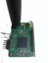


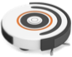

Rover: System Overview
Tag 1
Robot
CSI
IMU
Odometry Prediction
AoA Estimation
Tag 2
Error accumulation
Interference
AoA-IMU SLAM
Backscatter Localization
Localizing Backscatters by a Single Robot With Zero Start-up Cost
Shengkai Zhang, Wei Wang, Sheyang Tang, Shi Jin, and Tao Jiang. Huazhong University of Sci. & Tech.
9
Notes:
The system takes two sensing modalities, IMU and WiFi, to localize the backscatters. IMU provides accelerations and angular velocities to predict the odometry and CSI is used to infer the angle-of-arrivals of the robot to the tags. Then we feed the two kinds of measurements to a novel AoA-IMU SLAM module to compute the locations of the tags and the robot simultaneously. The first problem we encounter is the interference problem from multiple tags.

Slide 10
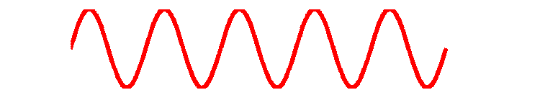
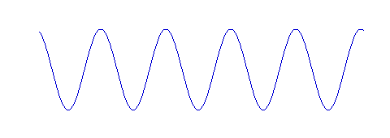
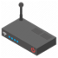
WiFi Backscatter AoA Estimation
Interference avoidance
5 GHz Spectrum (FCC)
Backscatter Interference
IEEE Channel #
36
40
44
161
165
20 MHz
……
Tag 1
Tag 2
Tag 3
……
Tag N
AP
Source Interference
Frequency hopping
Avoid sideband interference
AP
Localizing Backscatters by a Single Robot With Zero Start-up Cost
Shengkai Zhang, Wei Wang, Sheyang Tang, Shi Jin, and Tao Jiang. Huazhong University of Sci. & Tech.
10
Notes:
We provide an interference avoidance mechanism to address two kinds of interference. Since the AP will transmit much more powerful signals than the backscattered low-power signals, the source can overwhelm the backscattered signals. Moreover, since there are multiple backscatters transmit packets concurrently, their signals can interfere with each other. We employ a frequency hopping scheme by toggling the RF transistor of a tag at a different speed, e.g., 20 MHz. The backscattered signal will be moved to a channel that is 20 MHz away from the channel where the AP’s signal stays. Note that we set the channel of the AP’s signal as the channel at the ends of available ones, e.g., channel 165 or channel 36, because of the sideband interference when doing the frequency hopping.

Slide 11
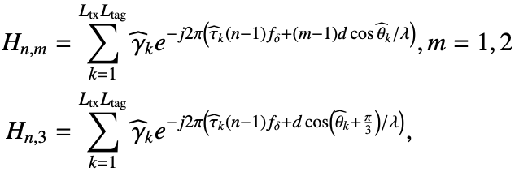


WiFi Backscatter AoA Estimation
AoA estimation
$L_{tx}$: No. of tx-to-tag paths
$L_{tag}$: No. of tag-to-rec. paths
Apply SpotFi [1] to estimate AoAs
[1] P. Kotaru, et al., “Spotfi: Decimeter-level localization using WiFi,” in Proc. ACM SenSys, 2016.
Localizing Backscatters by a Single Robot With Zero Start-up Cost
Shengkai Zhang, Wei Wang, Sheyang Tang, Shi Jin, and Tao Jiang. Huazhong University of Sci. & Tech.
11
Notes:
After addressing the interference problem, we start to estimate the AoA of the robot to a tag for localizing the tag via triangulation. Different from conventional WiFi localization systems, in the backscatter communication scenario, there are two parts of signal propagation: a signal will go through transmitter-to-tag paths and tag-to-receiver paths. The AoA of interest is only related to the tag-to-receiver paths. Suppose there are L_tx of tx-to-tag paths and L_tag of tag-to-receiver paths, and the receiver equips a three-antenna circular array. The signal model on the channel can be expressed in this way. This model is suitable to apply the state-of-the-art AoA estimation algorithm – SpotFi – to obtain the AoAs.

Slide 12
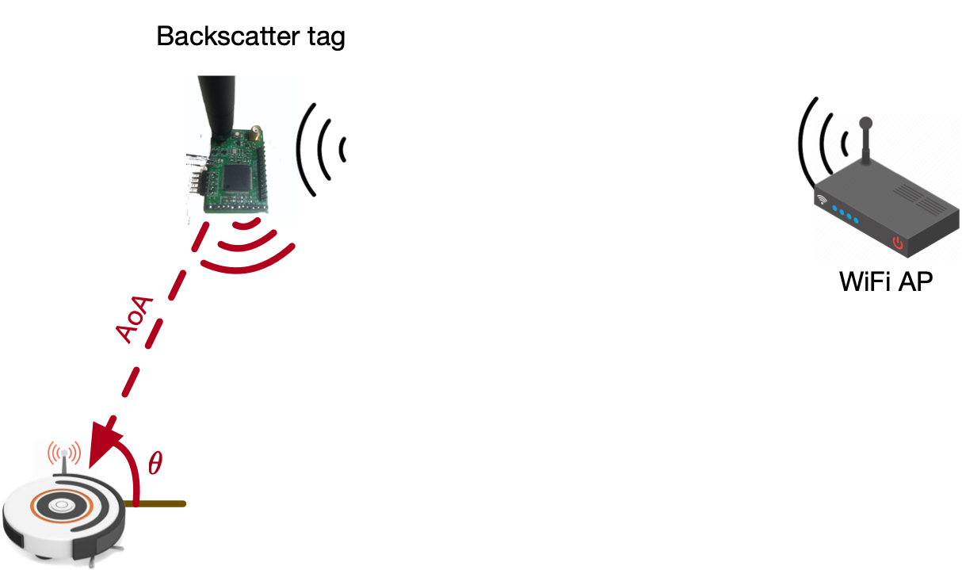
Rover: How to Localize Backscatters?
Localization principle
Problem: IMU drift
Obtained by WiFi CSI
Fusing AoA with
IMU measurements
AoA only cannot localize any device
Solution: Leverage the drift-free WiFi localizability to compensate the drift
Mobility – Multi-view
Obtained by IMU measurements
Localizing Backscatters by a Single Robot With Zero Start-up Cost
Shengkai Zhang, Wei Wang, Sheyang Tang, Shi Jin, and Tao Jiang. Huazhong University of Sci. & Tech.
12
Notes:
At this stage, we have obtained the AoAs of the robot to the tags. However, only the AoA from a tag cannot localize anything since there is no landmark. Moreover, there is no metric scale from the AoA, it is infeasible to establish a scaled reference system.
Fortunately, the robot is mobile. We take the mobility to construct multi-view constraints. Let’s take the two-view constraint as an example. The robot moves to another place, experiencing a translation delta d and it has a new AoA theta 2 at the new position. Note that, combining with the previous state, it forms a triangle with two angles. Furthermore, the translation can be measured by the IMU on the robot. Thus, the metric scale information is included. With two angles and the scaled edge, the triangle can be uniquely determined.
The problem is that IMU suffers from temporal drift. The amazing part is that the AoA is drift-free, i.e., the drift-free WiFi localizability, so that we can use it to significantly mitigate the IMU drift. Therefore, probably, we can fuse the WiFi AoA with the IMU measurements to localize the backscatter.

Slide 13
Rover: System Overview
Tag 1
Robot
CSI
IMU
Odometry Prediction
AoA Estimation
Tag 2
AoA-IMU SLAM
Optimization
Backscatter Localization
Localizing Backscatters by a Single Robot With Zero Start-up Cost
Shengkai Zhang, Wei Wang, Sheyang Tang, Shi Jin, and Tao Jiang. Huazhong University of Sci. & Tech.
13
Notes:
This comes to our core technique: the AoA-IMU SLAM framework. It is actually an optimization system.

Slide 14
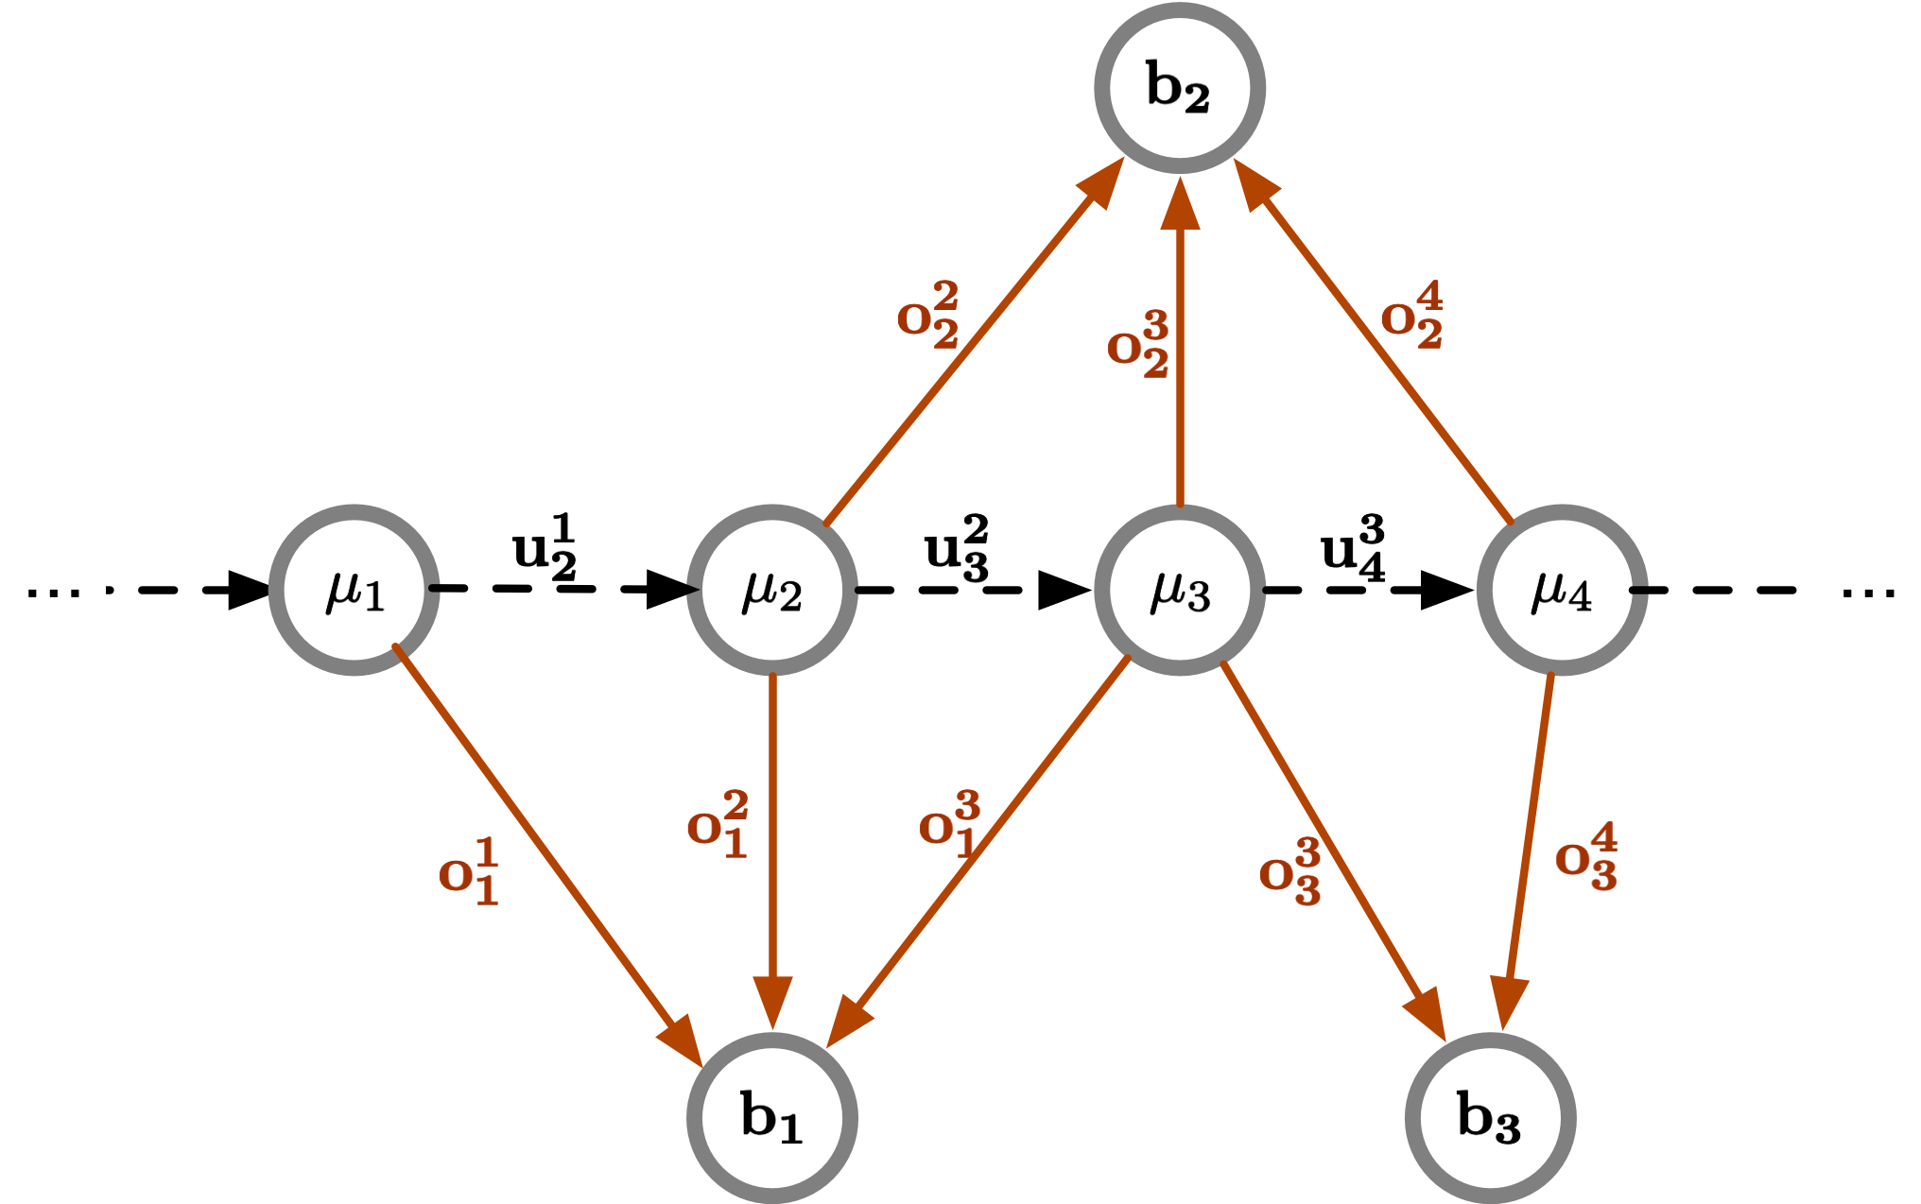
Rover: AoA-IMU SLAM
Graph representation
Hidden state: Backscatter location
Observation: IMU
odometry
Observation: Backscatter AoA
Hidden state: Robot location
Backscatters’ locations
Robot’s locations
Sliding Window: Select the hidden states and observations in a fixed length of time window
Full SLAM suffers from a large delay and computation cost
Sliding Window Formulation: $S={\left[μ_{0}, μ_{1}, …, μ_{n−1}, b_{0}, b_{1}, …, b_{m−1}\right]}^{T}$
Localizing Backscatters by a Single Robot With Zero Start-up Cost
Shengkai Zhang, Wei Wang, Sheyang Tang, Shi Jin, and Tao Jiang. Huazhong University of Sci. & Tech.
14
Notes:
We employ a graph based optimization framework. In this graph, the edges are constraints and the nodes are the hidden states. Each B denotes a backscatter location and each u denotes the robot’s location at a timestamp. The black dot edge is the odometry constraint, which can be observed by IMU. The red edge denotes the backscatter AoA constraint. Solving the full SLAM over the entire trajectory is very computation expensive and the results have a large delay. The robot will lose its navigation capability without real-time location updates. To achieve real-time processing, we use a sliding window fashion to bound the computation complexity. We only process the hidden states and their corresponding observations in a fixed length of time window. In this fashion, we formulate the state vector in this way.

Slide 15
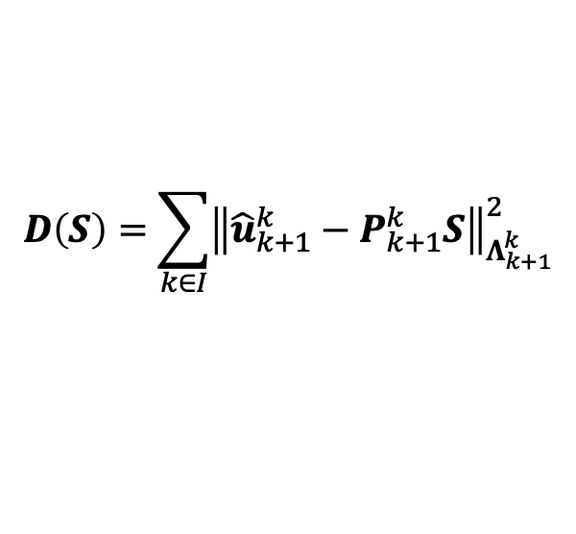
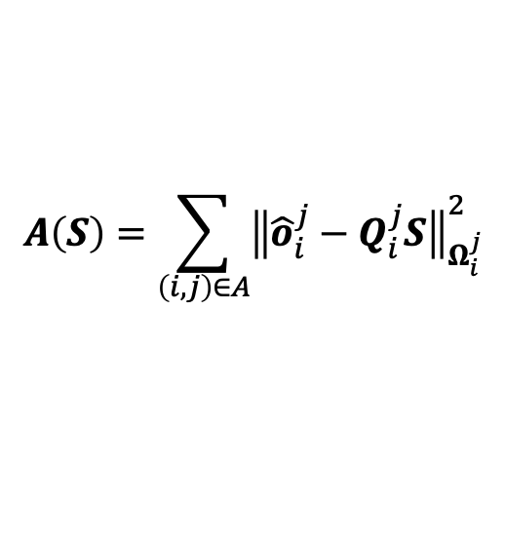
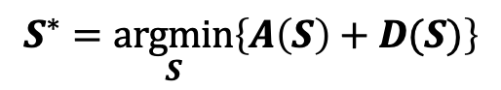
Rover: AoA-IMU SLAM
Problem formulation
Hidden state vector
$$S={\left[μ_{0}, μ_{1}, …, μ_{n−1}, b_{0}, b_{1}, …, b_{m−1}\right]}^{T}$$
Objective
$$S^{∗}=\underset{S}{argmin}\left\{A\left(S\right)+D(S)\right\}$$
$$A\left(S\right)=\sum_{\left(i, j\right)∈A}{{\left\|{\hat{o}}_{i}^{j}−Q_{i}^{j}S\right\|}_{Ω_{i}^{j}}^{2}}$$
AoA constraint
Mahalanobis
norm
Odometry constraint
$$D\left(S\right)=\sum_{k∈I}{{\left\|{\hat{u}}_{k+1}^{k}−P_{k+1}^{k}S\right\|}_{Λ_{k+1}^{k}}^{2}}$$
Observations
Localizing Backscatters by a Single Robot With Zero Start-up Cost
Shengkai Zhang, Wei Wang, Sheyang Tang, Shi Jin, and Tao Jiang. Huazhong University of Sci. & Tech.
15
Notes:
Let’s see the formulation of AoA-IMU SLAM. The objective is to find the configuration of the states that best satisfies all the measurement constraints. Basically, we have two types of measurements, which are AoAs obtained from WiFi CSI and odometry obtained from IMU. We would like to minimize the Mahalanobis norm of the residuals. For the measurement constraints, we observe the AoAs as O hat from frame i to frame j and odometry as u hat from frame k+1 to frame k.

Slide 16
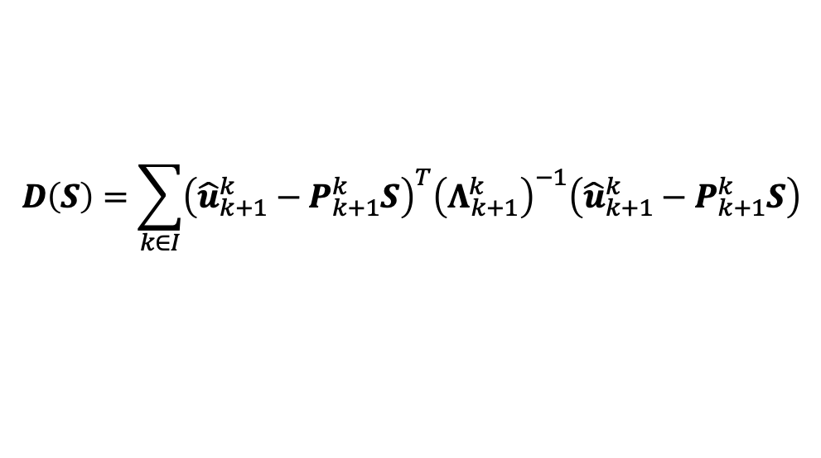
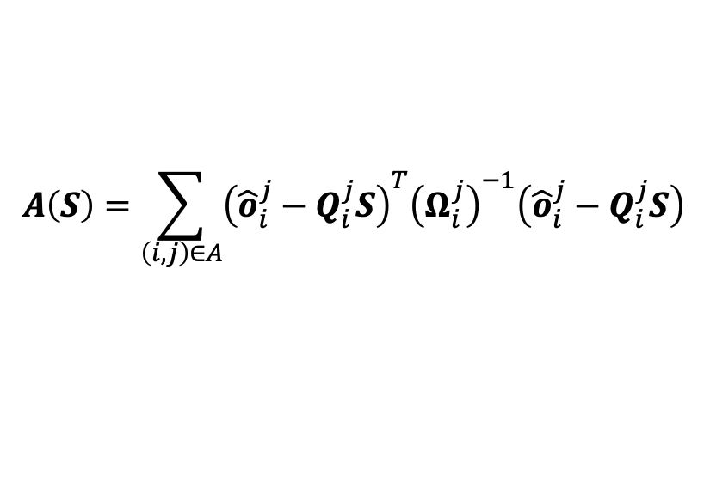
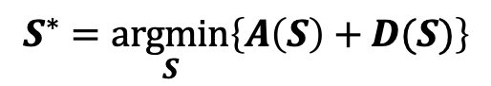
Rover: AoA-IMU SLAM
Objective
Specify the Mahalanobis norms
$$S^{∗}=\underset{S}{argmin}\left\{A\left(S\right)+D(S)\right\}$$
Mahalanobis norm of AoAs
$$A\left(S\right)=\sum_{\left(i, j\right)∈A}{{\left({\hat{o}}_{i}^{j}−Q_{i}^{j}S\right)}^{T}{\left(Ω_{i}^{j}\right)}^{−1}\left({\hat{o}}_{i}^{j}−Q_{i}^{j}S\right)}$$
Mahalanobis norm of odometries
$$D\left(S\right)=\sum_{k∈I}{{\left({\hat{u}}_{k+1}^{k}−P_{k+1}^{k}S\right)}^{T}{\left(Λ_{k+1}^{k}\right)}^{−1}\left({\hat{u}}_{k+1}^{k}−P_{k+1}^{k}S\right)}$$
Derive these terms to solve problem
Refer to the paper for the detailed derivation
Localizing Backscatters by a Single Robot With Zero Start-up Cost
Shengkai Zhang, Wei Wang, Sheyang Tang, Shi Jin, and Tao Jiang. Huazhong University of Sci. & Tech.
16
Notes:
The expansion of Mahalanobis norm can be expressed as follows. To solve the problem, we need to derive the prediction models to specify Q, P, Omega, and Lambda. Since the derivation is complicated and tedious, we omit the details here. Please refer to the paper for the details.

Slide 17
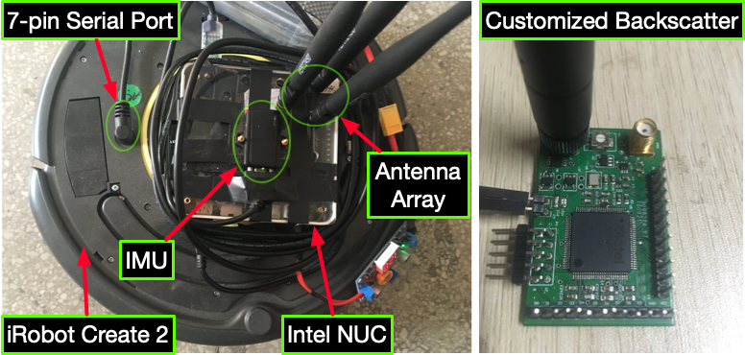
System Implementation
WiFi CSI: Linux 802.11 CSI Tool [1]
IMU: LORD MicroStrain 3DM-GX4-45
Backscatter: Customized tags adapted from HitchHike [2]
Robot: iRobot Create 2
Computer: Intel NUC equipped with an Intel 5300 wireless card
[1] D. Halperin, et al., “Tool release: Gathering 802.11n traces with channel state information,” ACM SIGCOMM Comput. Commun. Rev., 2011.
[2] P. Zhang, et al., “Hitchhike: Practical backscatter using commodity WiFi,” in ACM Proc. SenSys, 2016.
Localizing Backscatters by a Single Robot With Zero Start-up Cost
Shengkai Zhang, Wei Wang, Sheyang Tang, Shi Jin, and Tao Jiang. Huazhong University of Sci. & Tech.
17
Notes:
The system consists of four components: an iRobot Create 2 as the platform, a LORD MicroStrain IMU for odometry measurements, customized backscatters implemented by the open source project HitchHike, and an Intel NUC equipped with an Intel 5300 wireless card. The wireless card is hacked to extract the channel state information by the linux CSI tool. We attach the Intel NUC on the robot and control the robot to move along a predefined trajectory for experiments.

Slide 18
Evaluation
Deploy 4 tags in our meeting room
Microbenchmark: AoAs
System-level: Locations of the tags and the robot
Localizing Backscatters by a Single Robot With Zero Start-up Cost
Shengkai Zhang, Wei Wang, Sheyang Tang, Shi Jin, and Tao Jiang. Huazhong University of Sci. & Tech.
18
Notes:
The evaluation is conducted in the meeting room of our lab. We deploy 4 backscatter tags in the room. We focus on evaluating the microbenchmark, AoA accuracy, and the system-level performance, the localization accuracy of tags and the robot.

Slide 19
Evaluation: AoA Estimation
WiTag is the state-of-the-art solution without inter-tag interference
 | Rover | WiTag
LOS | 9.3º | 8.1º
NLOS | 18.1º | 14.6º
Multiple tags
with a single
AP
Single tag
with multiple
APs
Accurate AoA estimates for multiple tags
Localizing Backscatters by a Single Robot With Zero Start-up Cost
Shengkai Zhang, Wei Wang, Sheyang Tang, Shi Jin, and Tao Jiang. Huazhong University of Sci. & Tech.
19
Notes:
The AoA is the drift-free measurement that encode the location information to mitigate the IMU drift. Therefore, it is crucial to the whole system. We compare it with the state-of-the-art technique, WiTag. Basically, our AoA estimation differs WiTag from the interference among multiple tags. WiTag achieves decimeter localization accuracy with their AoA estimates. If we can achieve similar performance with the coexistence of multiple tags, then the AoAs can greatly help mitigate the IMU drift. From the result, we can see that in both LOS and NLOS conditions, our result is similar to WiTag. This shows that the AoAs are promising to mitigate the IMU drift.

Slide 20
Evaluation: Localization
 | Robot | WiTag
LOS | 39.3 cm | 74.6 cm
NLOS |  | 145.9 cm
Robot position tracking
Tags’ location error
Decimeter Backscatter Localization without Knowing the Position of Any Device
Localizing Backscatters by a Single Robot With Zero Start-up Cost
Shengkai Zhang, Wei Wang, Sheyang Tang, Shi Jin, and Tao Jiang. Huazhong University of Sci. & Tech.
20
Notes:
For evaluating the system-level performance, we move the robot over the room. The accuracy of the robot’s location is 39.3cm over the whole trajectory. The accuracy of the tags in LOS conditions, which correspond to tag 1, 2, and 3, is 74.6 cm. The accuracy of tag4, which is blocked by the office wall, is worse to 145.9 cm because the weak signal that penetrate the wall makes the CSI estimation from the wireless card is prone to noise. This degrades the AoA estimation performance.

Slide 21
Conclusion
An AoA-IMU SLAM framework enables a backscatter localization system with zero start-up cost
Sliding window formulation to bound the computation complexity for real-time processing
Implement a prototype with iRobot Create 2 and conduct extensive indoor experiments
Localizing Backscatters by a Single Robot With Zero Start-up Cost
Shengkai Zhang, Wei Wang, Sheyang Tang, Shi Jin, and Tao Jiang. Huazhong University of Sci. & Tech.
21
Notes:
The conclusion of Rover includes:
We propose an aoa-imu slam framework to enable a backscatter localization system with zero start-up cost.
To bound the computation complexity of the SLAM solution, we employ a sliding window formulation to achieve real-time processing.
We implement a prototype with iRobot create 2 and conduct extensive real-world experiments to demonstrate the effectiveness.

Slide 22
Thank you!
Localizing Backscatters by a Single Robot With Zero Start-up Cost
Shengkai Zhang, Wei Wang, Sheyang Tang, Shi Jin, and Tao Jiang. Huazhong University of Sci. & Tech.
22
Notes:
Thanks for your listening.

